Slide 1



Deep Learning Time Series Prediction Strategies for Efficiently Emulating Noah Land Surface Model Soil Moisture Dynamics
Mitchell Dodson^{1,2}
Dr. Chris Hain¹
Dr. Sundar Christopher²
Dr. Sean Freeman²
(1.) NASA SPoRT (MSFC)
+ NASA Water Insight
(2.) University of Alabama in Huntsville

Slide 2
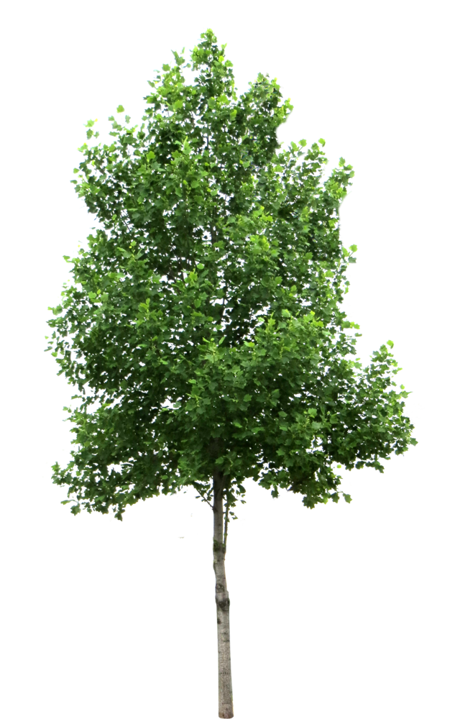

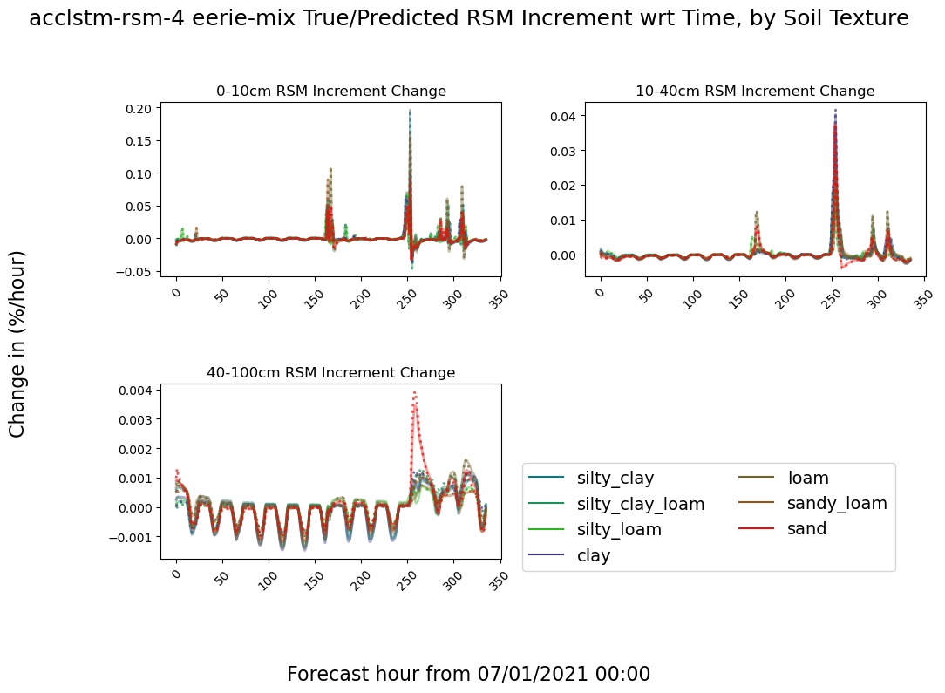
Overview and Goal
Schematic of Noah-LSM feedbacks & processes
(Xia et al., 2012)
canopy
interception
precipitation,
condensation
transpiration
canopy evaporation
Numerical models like the Noah Land Surface Model (Noah-LSM) are growing in resolution, complexity, and computational cost with time.
As such, there is a need for data-driven modeling techniques that can be quickly evaluated in a simple computing environment, which allows users to generate quick ensemble estimates and evaluate custom forecasts. These must also be physically valid + interpretable.
Hypothesis:
Artificial Neural Networks (ANNs) can emulate the soil moisture dynamics of Noah-LSM.
Physical reasoning can be applied to the interpret the predictions from ANNs.
Custom manipulations to the ANN training process can improve their ability to make accurate predictions.
Previous literature uses ANNs to:
Simulate rainfall/runoff for a catchment (Kratzert et al., 2018)
Short-term single-layer soil emulation (Filipovic et al., 2022)
Generalize from in-situ observations (O. & Orth, 2021)
This is the first effort we are aware of that uses ANNs to emulate a multi-layered land surface model at high temporal resolution (1 hour) for more than a handful of timesteps (predicting to 2 weeks).
Infiltration
sublimation
snow melt
runoff
0-10cm
10-40cm
40-100cm
100- 200cm
direct evaporation
Frozen Soil
root uptake
vertical moisture flux
sub-surface runoff
Hourly Time Derivative, henceforth the “increment”
Precip
Infiltration
Downward
conductance
transpiration
Notes:
Numerical models are complex and computationally expensive, especially high-resolution next-gen systems.
Data-driven techniques offer better ease of use and generally faster execution speed, but are black boxes.
I want to show that
It is possible to simulate physical dynamics of soil moisture in multiple layers at high temporal resolution, and for long prediction sequences.
That I can “open” the black box by applying physical reasoning and evaluation.
That novel modifications to the learning process can improve the performance of models.
Previous literature focuses on rainfall-runoff for an entire catchment, or single soil layers for short periods of time.
Example of time series out to 2 weeks with multiple soil textures.

Slide 3
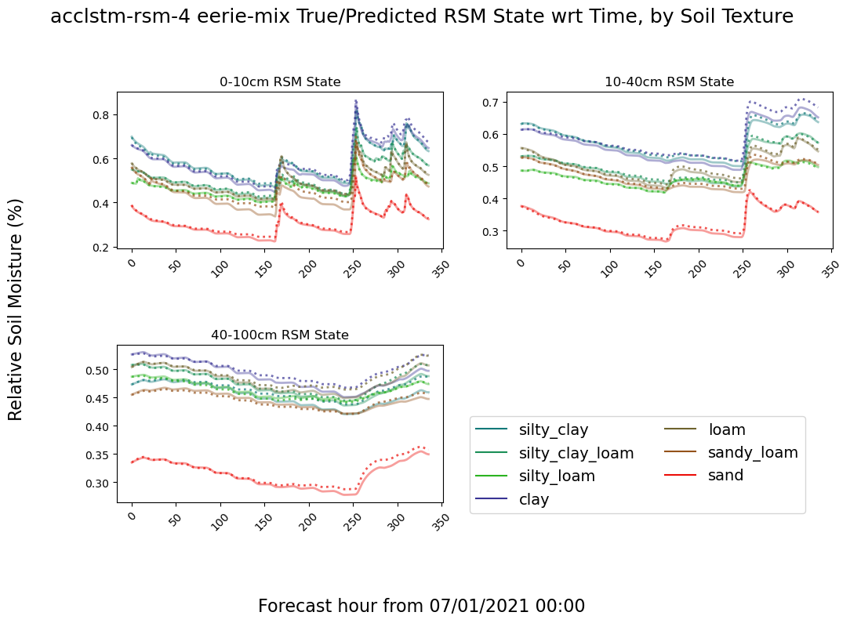
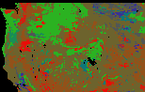
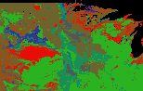
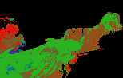

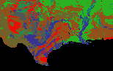

NLDAS-2/Noah-LSM background
Example of Noah-LSM and Prediction Dynamics
Soil Moisture Evolution Over 2 Weeks, by soil texture
Noah-LSM is a 1D model with 4 discrete depth layers of thicknesses 10cm, 30cm, 60cm, and 100cm (only first 3 considered here).
Outputs on ⅛º (~13.9km) grid over CONUS
Most NLDAS-2 forcings are are derived from NARR, precip from CPC/PRISM, and insolation aided by satellite-derived products.
Dynamic inputs:
SW/LW Radiation
Wind speed/bearing
Temperature
Mixing ratio
Precipitation
Pressure
Green Veg Fraction
Leaf Area Index
Snow Water Equivalent
Static inputs:
Soil texture component percentages (STATSGO)
Elevation & stdev (USGS)
Vegetation type (UMD classes)
Soil texture RGB (sand,silt,clay) and pixel counts per region
NW: 13,848px
NC: 13,509px
NE: 6,420px
SW: 4,767px
SC: 9,907px
SE: 4,005px
Notes:
I try to predict the dynamics of the Noah-LSM, using meteorological inputs and static parameters from the NLDAS-2 framework
NLDAS-2 has independent pixels and 4 soil layers, 1/8 degree gridded domain over CONUS
Most forcings are from the NARR, precipitation from the CPC and PRISM, satellite-derived downward solar radiation.

Slide 4
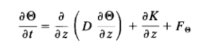
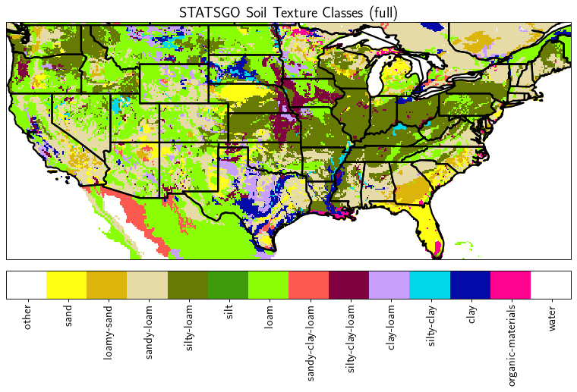
Soil Physics Basics
(Chen et al., 1996)
Noah-LSM soil hydrodynamics are governed by the diffusive Richards equation
Diffusion across moisture gradient
Downward percolation from conductance
Extraction from evapotranspiration + base flow
All strictly dependent on soil properties defined in terms of (sand, silt, clay) particle size distribution.
Porosity: maximum water capacity
Field Capacity: water retained by capillary action against the force of gravity
Wilting Point: water content remaining after maximum amount extracted by vegetation
B Parameter: exponential coefficient governing rate of decline in conductivity as soil dries.
Coarser soils have a higher rate of conductance and diffusion, lower field capacity and wilting point, and their conductance diminishes more slowly as the soil dries.
Change in soil
moisture state
Diffusion to
drier layers
Downward
conductance
Evapotranspiration
(Miller et al., 1998)
Notes:
Movement of soil moisture between layers is prognosticated by the diffusive Richards equation
Diffusion across moisture gradient (can move water upwards) conduction downward, and evapotranspiration
All terms strongly depend on soil texture, which is encoded in terms of the sand, silt, and clay components of the soil.
Coarser soils have higher conductance and faster diffusion, generally lower porosity.
Map of soil texture shows the heterogeneity throuhgout the domain.

Slide 5
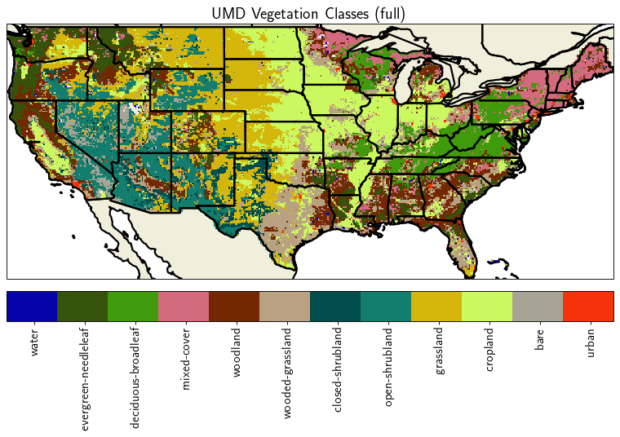
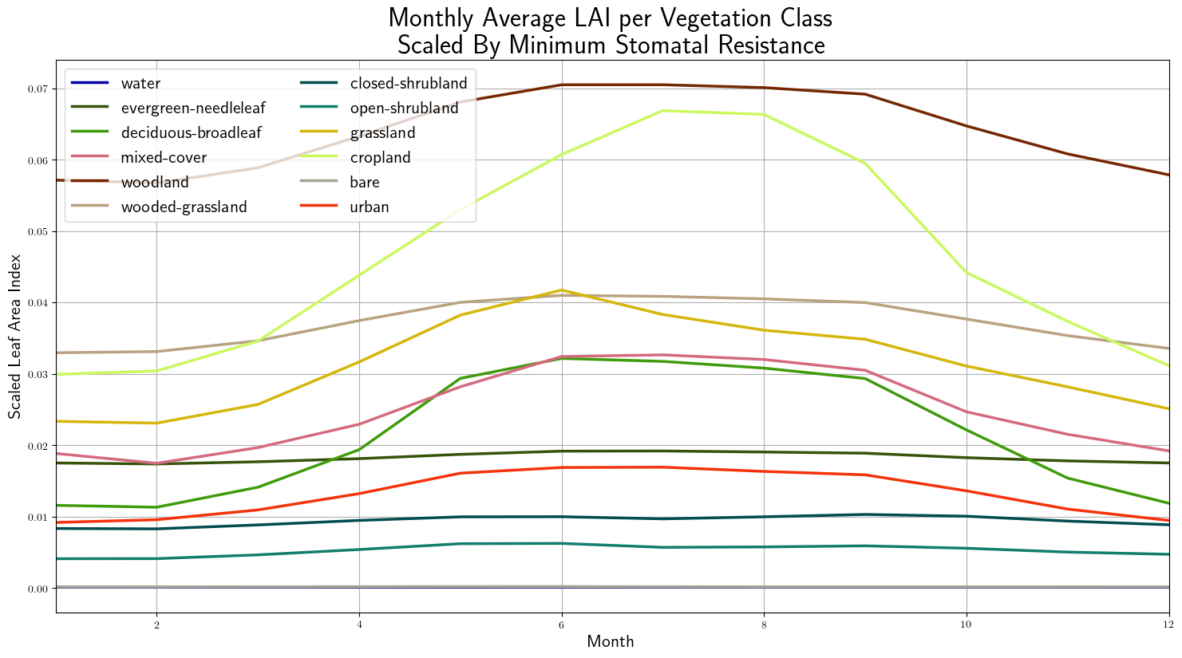
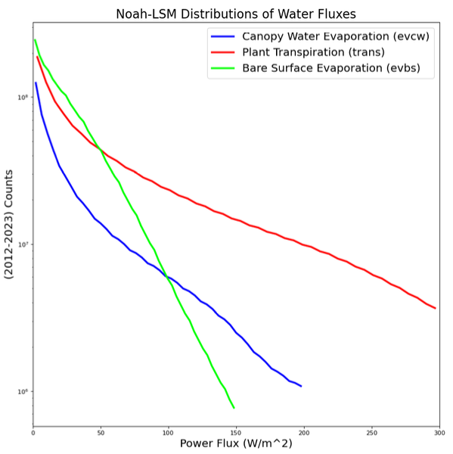
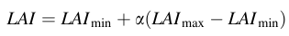
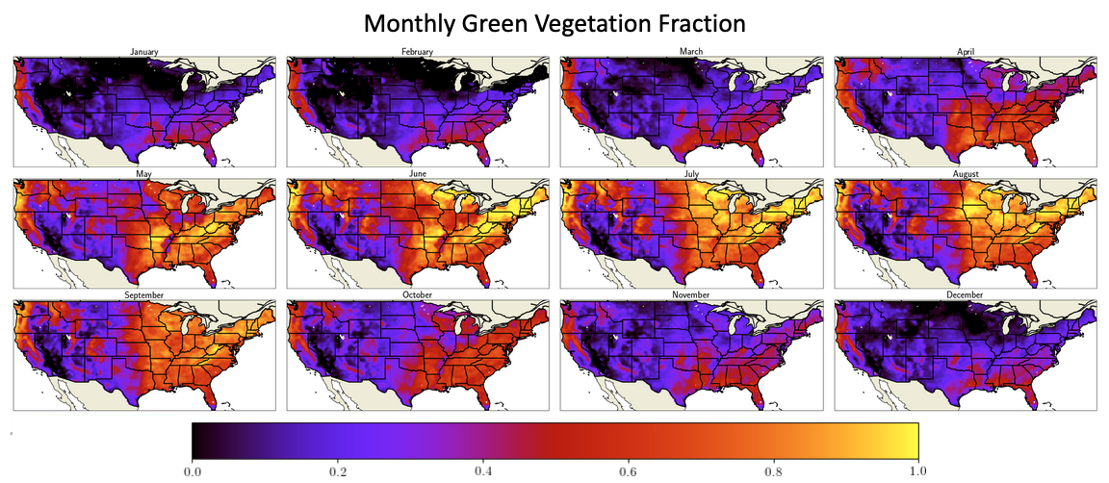
Jarvis Vegetation Model
(Hansen et al., 1998)
(Jarvis et al., 1976)
Plant transpiration depends on:
Stomatal resistance and leaf area index (LAI) of the vegetation type.
Satellite-derived green vegetation fraction (GVF).
Amount of plant-available water for root uptake.
Surface air temperature and dewpoint depression.
Amount of solar radiation.
Potential evaporation from Penman equation
Vegetation class sets bounds on LAI, which are subsequently scaled by the GVF. This make some categories far more sensitive to seasonal variation.
(Gutman et al., 1998)
Cropland strongly seasonal
Transpiration is most significant water flux
Notes:
Plant transpiration is the most significant factor for removing water from the soil column.
Each plant type has unique bounds on LAI that are varied between according to the GVF.
Also have unique constant stomatal resistance parameters that directly scale transpiration along with GVF
GVF is highly regional and seasonal, derived from AVHRR data.
Cropland is the most strongly seasonal vegetation type.

Slide 6
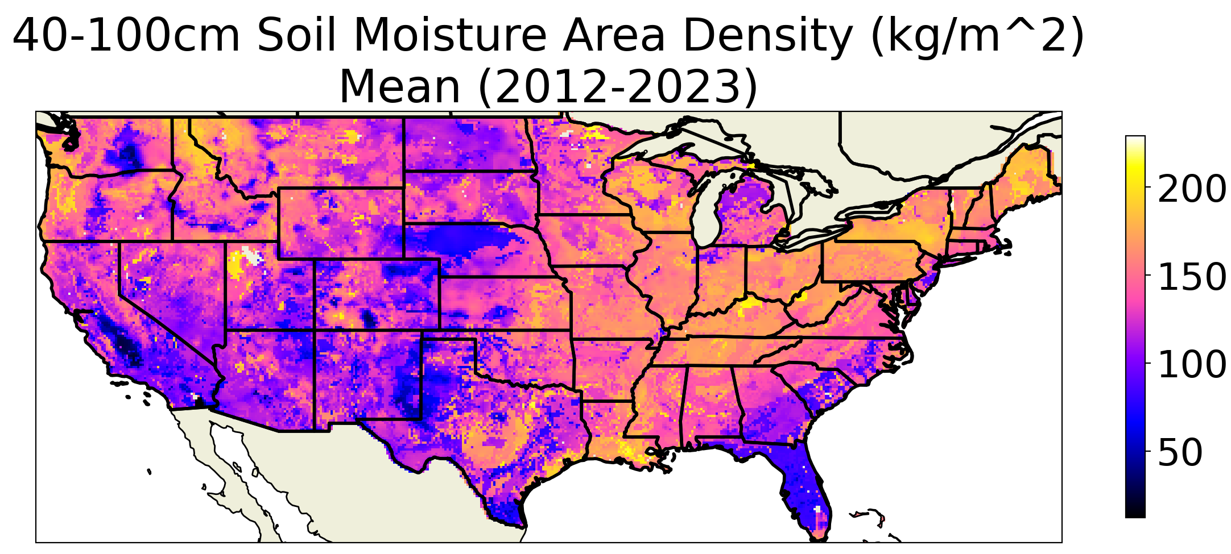
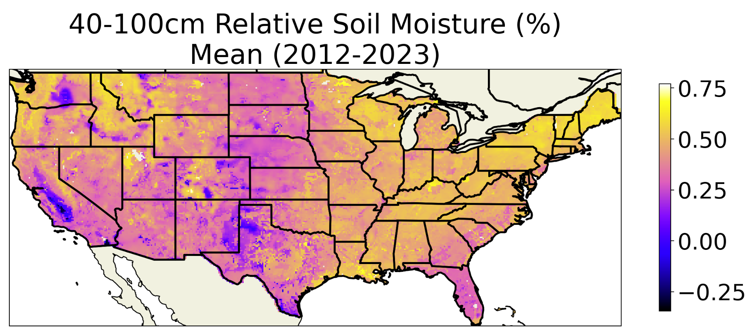
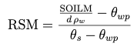
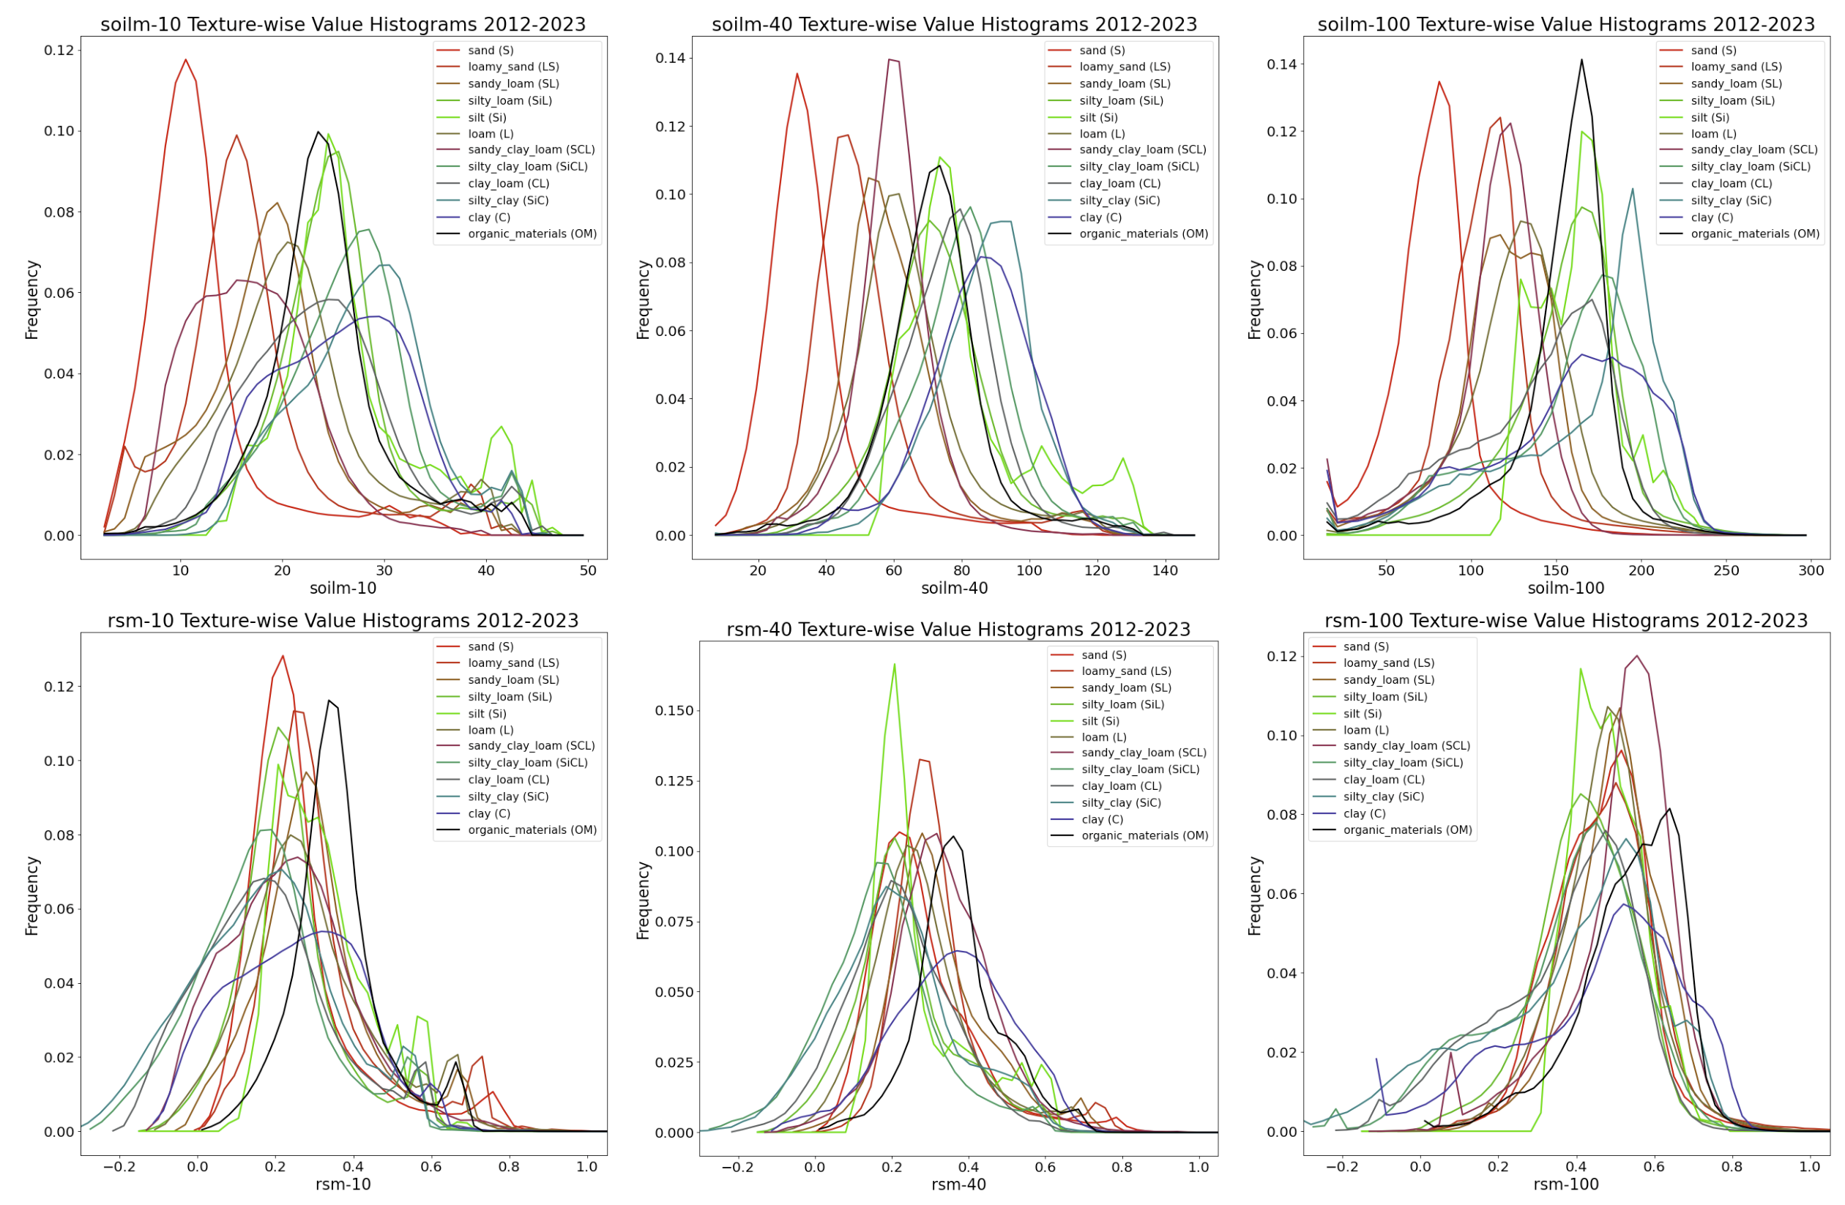
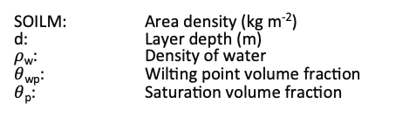
Soil Moisture Metrics
Noah-LSM provides soil moisture values in area density quantities (kg m⁻²) per layer, which are implicitly volumetric (kg m⁻³) when the layer depth is divided out.
Different soil textures have distinct characteristic scales due to their individual water-holding abilities.
We will also consider the Relative Soil Moisture (RSM), which mitigates stratification by soil texture by normalizing each between the wilting point and the porosity
SOILM: Area density (kg m⁻²)
d: Layer depth (m)
$ρ$_{w}: Density of water
$θ$_{wp}: Wilting point volume fraction
$θ$_{p}: Saturation volume fraction
Distribution of volumetric soil moisture per texture
Distribution of relative soil moisture per texture
Notes:
Volumetric soil moisture is a mass quantity that has characteristic ranges that are unique per vegetation type.
We will mainly focus on RSM, which mitigates differences in the value range between soil textures and layers by normalizing between the wilting and saturation points.

Slide 7
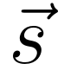
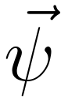
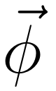
Process-based Modeling and Discrete Integration
Noah-LSM is a series of explicit representations of physical processes described by coupled differential equations with a variety of parameterizations, which cannot be analytically solved.
No context maintained other than previous state output.
In order to remain numerically stable when integrated using a locally linear assumption (Crank-Nicholson method), Noah-LSM uses 15 min timesteps, which are aggregated to 1 hour.
Much compute goes to estimating the highly nonlinear function with small linear segments.
Advantage: Explicit knowledge and control of the model’s processes
Disadvantage: Complex and inflexible, manually tuned to a relatively small subset of data using discrete parameterization schemes.
0
1
H-1
A
A
A
-1
0
H-2
-1
0
H-2
Self-cycling numerical model schematic
Notes:
In practice, numerical models like Noah-LSM are a collection of coupled differential equations that cannot be analytically solved.
Lots of computation is dedicated to making linear approximations at very fine time steps to remain numerically stable.
With explicitly-encoded equations, you have exact knowledge of the processes that affect model behaviors
HOWEVER expands in complexity as new processes added, and individual phenomena are manually calibrated to a small subset of data.

Slide 8
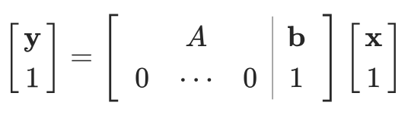
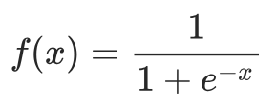
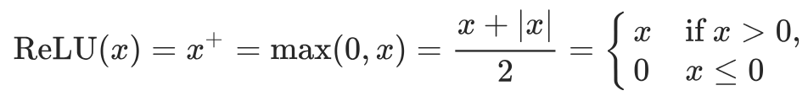
Data-driven modeling with Neural Networks
Neural Network “Layer” Schematic
Deep learning methods are distinct in that they can:
Adapt to data characteristics from exposure to examples rather than manually encoding processes as equations.
Emulate the nonlinearities of the data at a coarser time step
Maintain contextual information between time steps
Represent the relationship between initial states, static parameters, atmospheric forcings, and output states in terms of a computationally simple sequence of operations.
In practice, an artificial neural network (ANN) is constituted by a composition of linear (affine) matrix transformations, separated by element-wise nonlinear activation functions.
This structure enables ANNs to be universal function approximators
Affine Operation
Translate
Rotate
Shear
Next
Layer
Nonlinear
Activation
Layer 1
Layer 2
Layer 3
Element-wise
nonlinearity
x
Ax+b
Ax+b
Ax+b
y
Notes:
Data-driven approaches to modeling adapt to the dataset behaviors through exposure to input/output pairs.
Can be highly nonlinear operator between timesteps, so locally-linear assumption doesn’t need to be made.
Can also maintain statistical information between timesteps.
Neural networks are comprised of alternating linear affine matrix operations and element-wise nonlinearities.
Can theoretically learn any decision boundary or regression task with sufficient number of parameters and at least 2 layers.,

Slide 9
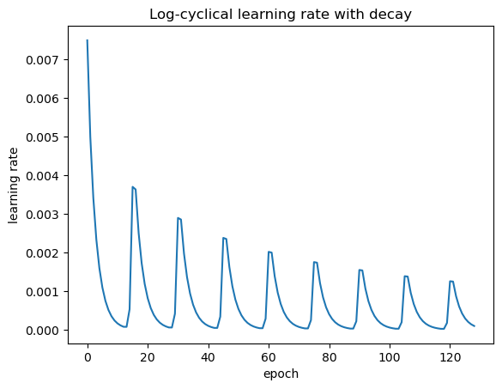
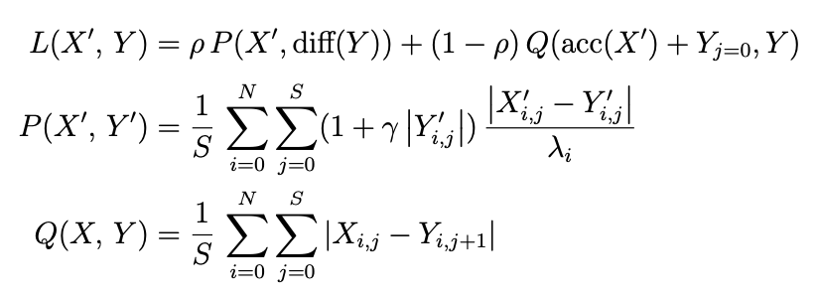
Loss function and learning process
(Smith, 2017)
During training, neural networks use the backpropagation algorithm to iteratively modify learnable parameters with the goal of optimizing a differentiable loss function, which characterizes the skill of the model for each input/output pair.
Since the entire ANN is differentiable, the chain rule can be applied to determine the gradient of loss with respect to each learnable weight in the network. The magnitude of updates to the weights depends on the learning rate.
We introduce three custom manipulations to the loss that will be treated as independent variables:
Increment Ratio balances local increment loss with the integrated state loss of the full sequence.
Magnitude Bias emphasizes cases where the true change in soil moisture is high
Layerwise Norming modulates the amount of loss contributed by each of the outputs.
Increment ratio
Full loss function
Increment loss
Layerwise
norming
State loss
Magnitude bias
Mean absolute error
base loss function
Notes:
Differentiable loss function is needed to score model performance
During training, backpropagation determines the gradient of the loss with respect to each learnable weight,
adjusts them accordingly by an amount determined by the learning rate.
Novel contribution: we add custom manipulations to the loss function to explore the possibility of improving learning:
Increment ratio adjusts loss contributions between the hourly divergence from the increment change and the integrated state of the full time series up to that point
Want to be able to recover from previous errors to improve overall results.
Magnitude bias emphasizes samples with high magnitudes of change in soil state.
Significant precipitation and infiltration events hare brief but have disproportionate effect on the time series.
Layerwise norming of the incremnet change modulates the amount of loss from individual outputs.
Want to be able to adjust how much the learning process focuses on individual layers.

Slide 10
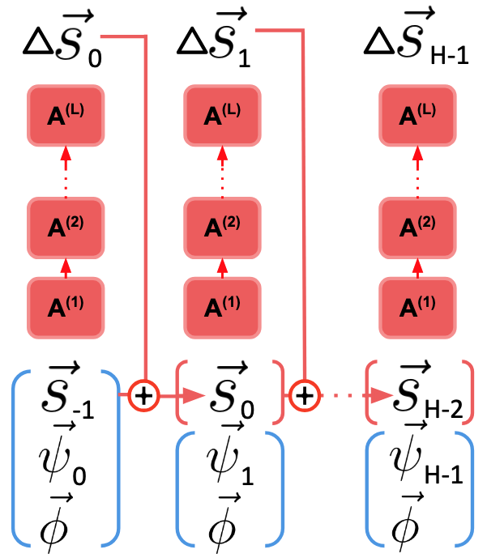
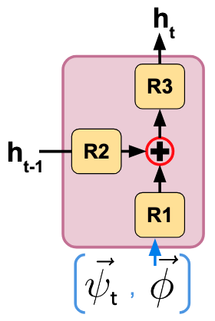
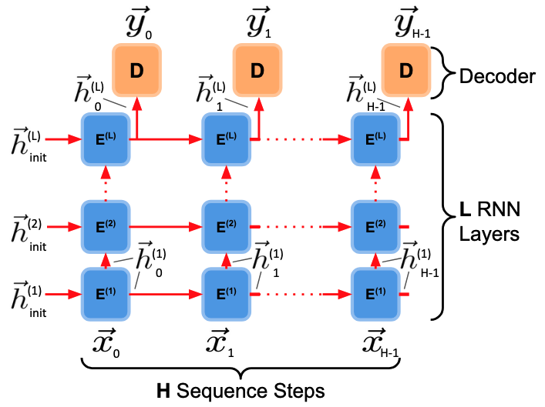
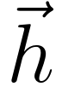
Neural Net Architectures: FNN & RNN
FNN architecture
Like the numerical model, the most basic neural net type, the fully-connected neural net (FNN) self-cycles its previous output as a new input at each timestep.
It contains no latent vector passed between steps, which theoretically limits its ability to learn generalizations over time.
The recurrent neural network (RNN) addresses this by generating a high-dimensional latent vector h at each step, which is decoded to produce the output, and also passed along to the subsequent time step as an additional input.
The latent vector has arbitrary dimensionality, and typically isn’t directly interpretable.
Generic RNN architecture
RNN Cell
k
: Current forcing
k
: Land surface state
: Static parameters
: Hidden (latent) state
Notes:
Basic FNN imitates numerical model in that it only propagates its previous predictions to subsequent timesteps.
RNNs attempt to preserve information by calculating a hidden state that is passed along at each layer.

Slide 11
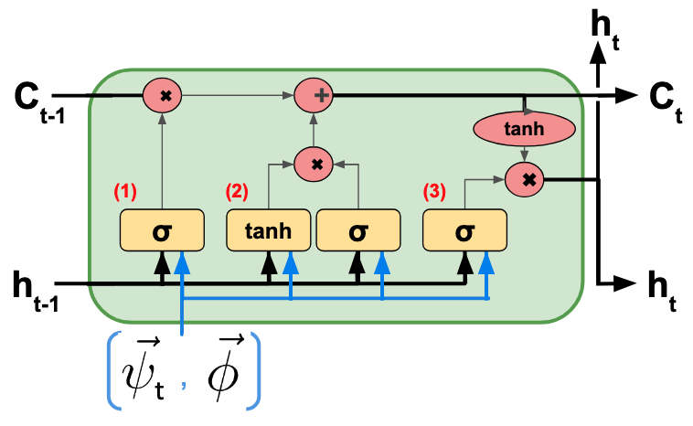
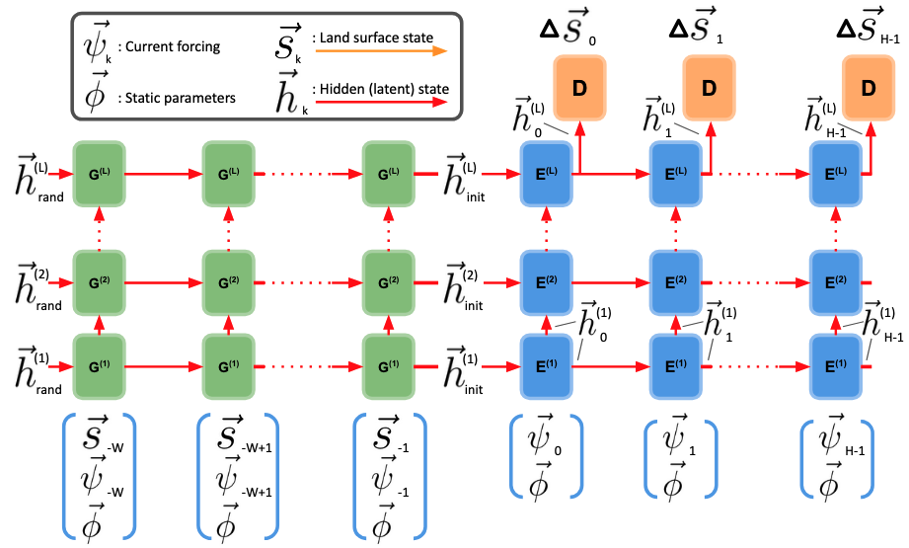
Neural Net Architectures: RNN and LSTM
RNNs apply full matrix transformations to inputs and latent vectors at each step, which distorts information quickly and makes training less stable (vanishing and exploding gradient problem).
The long short-term memory (LSTM) architecture addresses this by only linearly modifying the latent vector at each step.
Problem structure includes a 24 hour spin-up before the first timestep (where Noah-LSM soil states are an input).
At the first prediction step and beyond, the model is only provided the dynamic forcings and static parameters.
All models target the increment change in soil state.
Notes:
RNNs vulnerable to vanishing and exploding gradients because they apply learned matrix operations directly to the latent vector passed between timesteps.
The same weights are updated for each timestep, which can cause them to explode or go to zero, and stop learning
LSTMs solve this by instead using the weights matrix to generate linear coefficients that scale the vector which is passed between timesteps.
Window period spins up the model with soil states as well as forcings, then only forcings and static parameters provided during the 2 week prediction sequence.
Outputs of the model are ultimately the increment change in soil state for each layer.

Slide 12
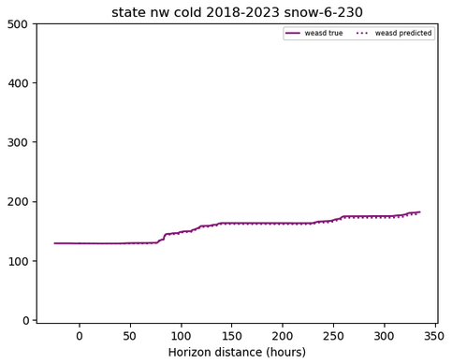
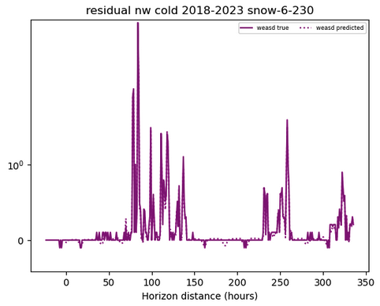
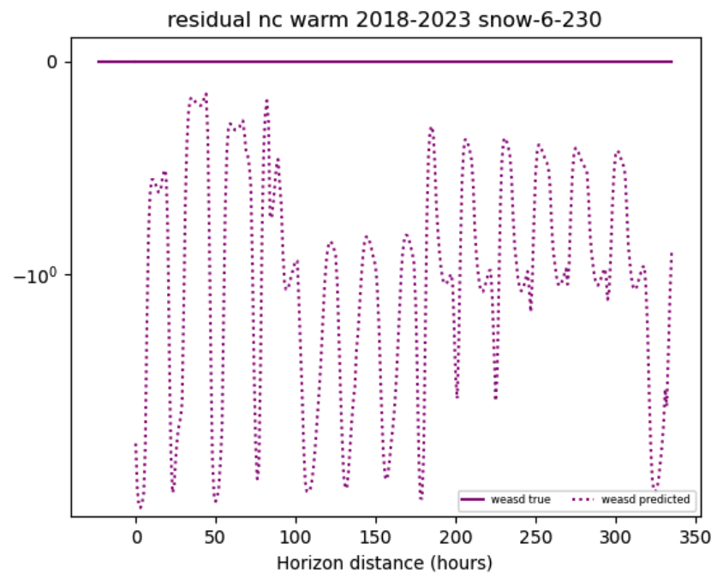
Handling Snow
Early exploratory models treated snow as an additional soil layer, but effectively always predicted zero change due to the transience of snowfall.
Models trained to only predict snow -- along with a loss function manipulation that ignored negative predictions when there was no snow pack -- showed promising results.
Snow is a critical predictor, so we treat Noah-LSM snow water equivalent as an input to the ANNs. Integration and evaluation of a dedicated snow emulator is considered future work.
Snow Water Equivalent Predictor Output
Increment Change SWE Predictor Output
Increment Change SWE Predictor Warm Season Example
SWE (kg m⁻²)
Increment SWE (kg m⁻² h⁻¹)
Notes:
Snow was initially treated as a separate soil layer, but models would universally predict zero change since it is relatively rare.
Exploratory models trained to exclusively predict snow showed promising results
From this point forward, we use the Noah-LSM values for snow water equivalent as a dynamic input
In the future, we expect to integrate an ANN dedicated to predicting snow to initialize the soil moisture models.

Slide 13
Training data, Evaluation Challenges and Strategies
Data selection:
Training and validating on all data 2012-2018 with 66.7% training split.
Testing on all data 2018-2024
Sample initialization points separated by at least 31 hours to preserve variety.
Independent variables:
Model target (Soil moisture area density or relative soil moisture)
Model type (FNN, RNN, LSTM)
Loss function parameters
Number of layers and weights per layer
Hyperparameters (activation function, batch normalization, dropout, etc).
Effective evaluation is difficult because:
Model configuration has a large number of independent variables
Dynamics depend strongly on relatively rare events like precipitation, runoff, snow melt.
Static parameters like vegetation and soil texture have a significant and discrete influence on temporal dynamics.
Characterizing performance in terms of meteorological context since input variables are highly auto-correlated and nonlinear.
Notes:
2012-2018 are split 2/3 training and 1/3 validation, testing on separate years 2018-2024
Initial times of samples are separated by at least 31 hours to preserve uniqueness of the time series.
Independent variables for model training include the units of the prediction target, the model type, custom loss function parameters, and other hyperparamters
Must be careful in evaluating due to
the large number of model parameters
dependence on rare events
discrete differences between static inputs
highly multicolinear and autocorrelated inputs and outputs

Slide 14
Training and Evaluation Methodology
Train 12-20 models within each category, varying multiple parameters simultaneously (model size, # layers, activation function, learning rate, etc.).
Categories include FNN targeting RSM, RNN targeting RSM, LSTM targeting volumetric soil moisture, and LSTM targeting RSM.
Select the best model from each category for further evaluation (spatial, temporal, efficiency, performance wrt distributions of input data).
For the best overall model, identify seasons and regions with anomalous ANN behavior and analyze on a smaller scale to determine contributing phenomena.
Independently vary loss manipulations and observe effects on results.
Retrain models with individual inputs excluded to estimate feature importance.

Slide 15
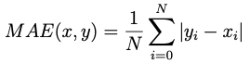
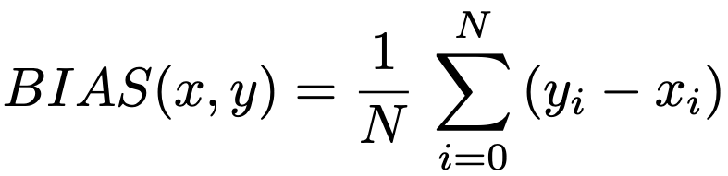
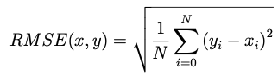
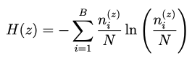
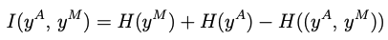
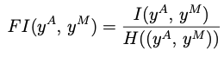
Evaluation Metrics
Mean Absolute Error (MAE): The average magnitude of divergence between ANN predictions and Noah-LSM values (in RSM coordinates).
Bias: Average positive or negative divergence between ANN predictions and Noah-LSM values.
Root Mean Squared Error (RMSE): Similar to MAE, but square divergence; more sensitive to outliers.
Fractional Information (FI): Entropy-based metric calculated from the global joint histogram of ANN predictions and Noah-LSM values.
Inversely related to the uncertainty introduced by utilizing ANN predictions rather than fractional information; more sensitive to global properties rather than average performance.

Slide 16
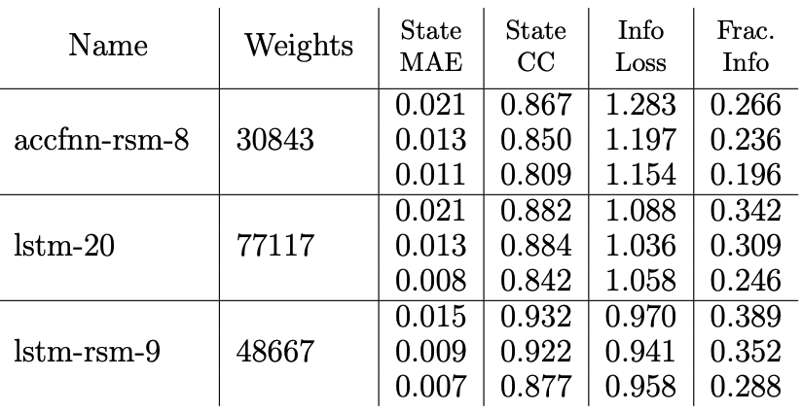
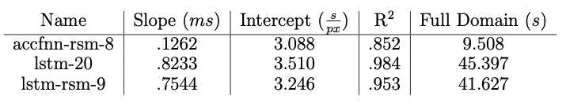
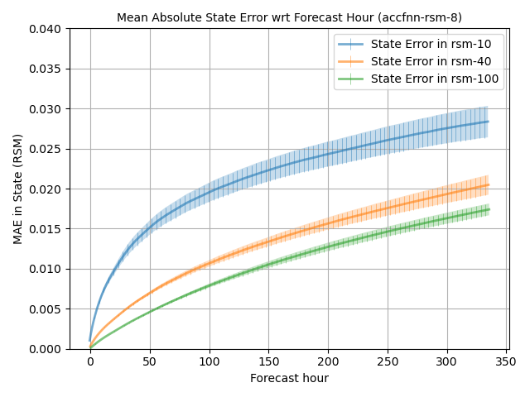
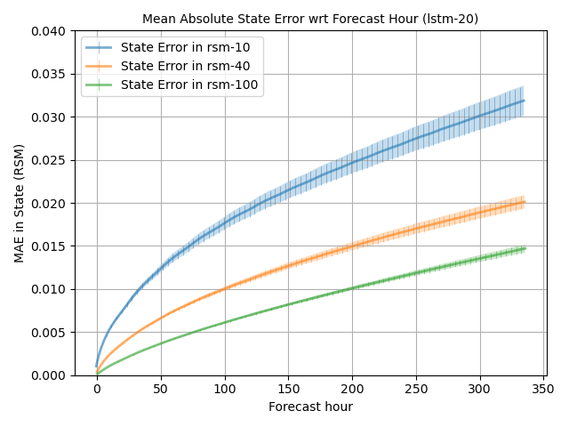
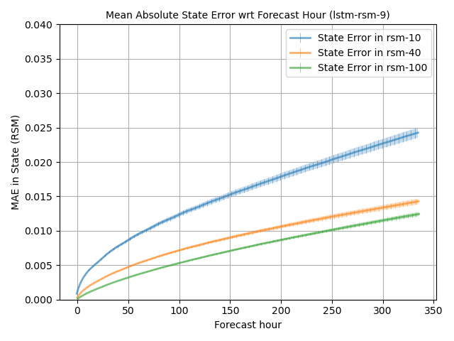
Results: Best Models in Each Category
Bulk Statistics and Size of Best Models
In terms of bulk statistics, RSM-targeting LSTM performed best in all layers and by all metrics, and was considerably smaller than the best LSTM-VSM.
FNNs performed on par with LSTM-VSM in the surface layer under normal conditions, but had higher error variance and lower fractional information. FNNs also had the fastest execution time by a large margin.
Basic RNNs were vulnerable to the exploding gradient problem given the long prediction sequence, and struggled to converge.
FNN-RSM
LSTM-VSM
LSTM-RSM
Execution Speed of Best Models (single thread CPU)
FNN-RSM wrt Forecast Hour
LSTM-VSM wrt Forecast Hour
LSTM-RSM wrt Forecast Hour
Notes:
Best FNN was fastest, but worse and less consistent than the other models.
Best LSTM targetting VSM was much larger than LSTM-RSM, worse performance in all layers.
LSTM-RSM performed best in all metrics and layers. Will continue to analyze that.

Slide 17
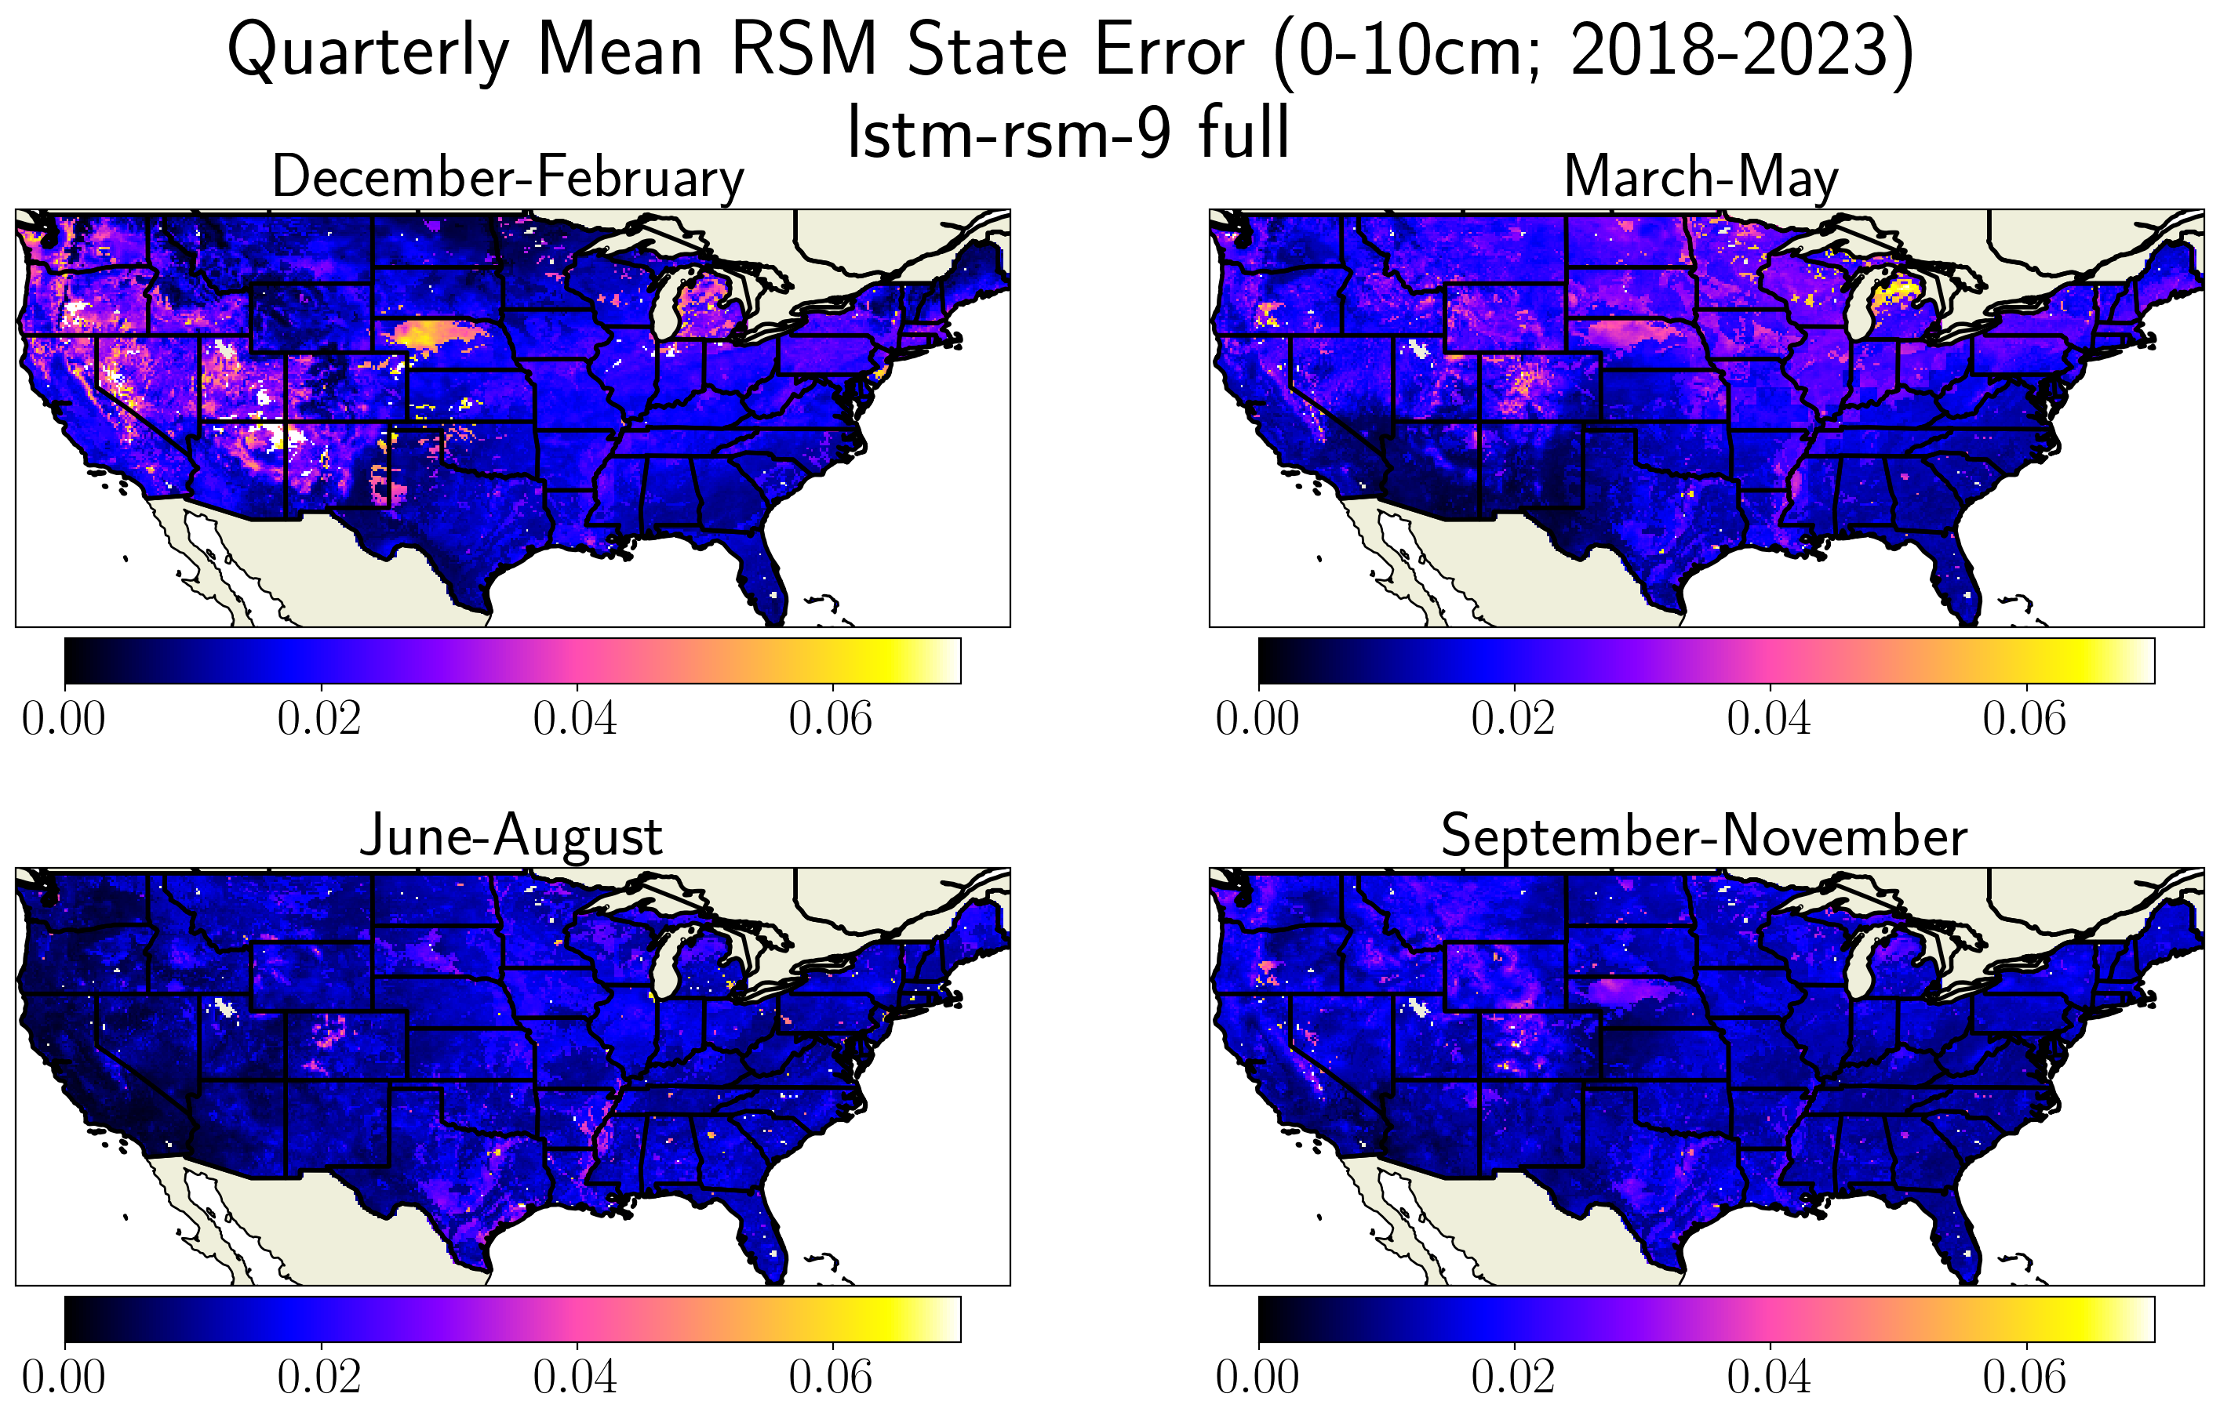
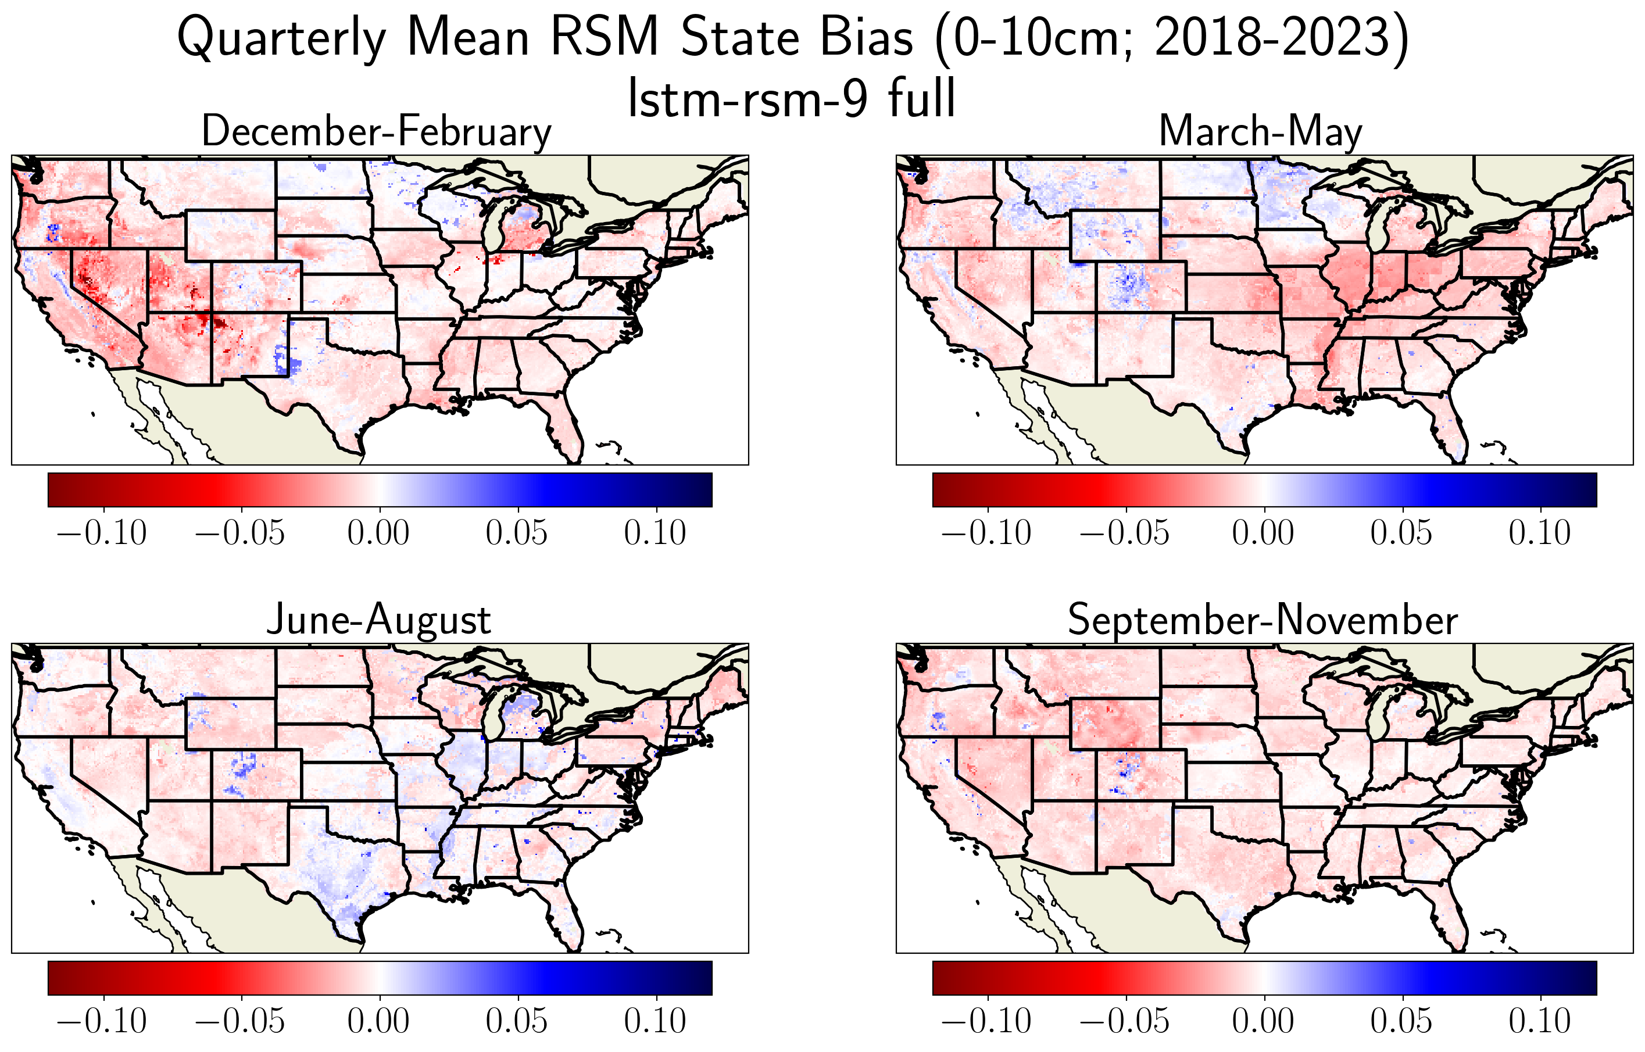
Spatial characteristics in 0-10cm layer
Cold Season:
Highest error rates were associated with sandy soils in Michigan and Nebraska, without conclusive bias, and desert West with a considerable dry bias.
In spring, high altitudes biased wet, and midwest associated with dry bias.
Warm season:
Clay-dominant Mississippi Alluvial plains are worst, along with Colorado peaks. Both wet-biased.
In general:
The surface layer has a widespread slight dry bias
Notes:
Highest error rates associated with sandy pixels, especiallly in the cold season
Results dominated by a slight dry bias.

Slide 18
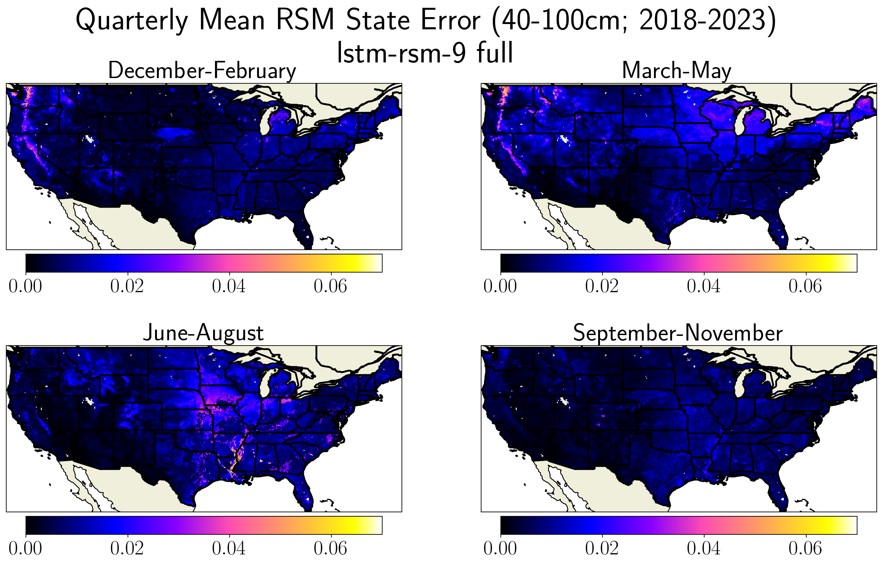

Spatial characteristics: 40-100cm layer
Cold Season:
Western mountains and Nebraska Sand Hills still have high error rates in the winter, while in the spring the Midwest has high error and a dry bias associated with a 1-degree tiling artifact
Warm season:
Widespread wet bias still closely matches the cropland soil texture, especially in clay-dominant pixels.
Notes:
40-100cm deep layer is generally wet-biased throughout the year, except dry bias in the Midwest spring.
Wet bias closely contouring cropland in the Midwest and Mississippi River Valley is even more extreme at this layer

Slide 19


40-100cm Layer Slope Type Tiling Artifact
The lower layers were affected by a 8x8 pixel (1 degree) tiling artifact. We determined that this source of unexplained variance was related to a previously-unknown categorical parameter that governs the drainage rate from the bottom layer of the model.
Dry-biased pixels correspond to slower drainage rates because the ANNs over-estimate the rate of removal of water from the deeper layers.
40-100cm Layer Bias
Notes:
Noticable dry-bias tiling artifact in midwest closely corresponds to previously-unknown slope type categorical parameter
Drier pixels align with lower drainage efficiencies from the bottom layer of the model.
This suggests that the ANN is over-estimating the rate of removal of water in the deep layer by base flow.

Slide 20

Model performance wrt Surface Air
The highest error rates were associated with air that is above freezing and close to saturation, which corresponds to a strong dry bias.
This is likely due to over-estimation of the rate of plant transpiration and bare surface evaporation, which are substantially reduced as the dewpoint depression approaches zero.
There is also a maximum in dry bias right at the freezing point.
Notes:
Joint histogram of surface temperature and mixing ratio contours clausius clapeyron curve
Error maximum above ~80% relative humidity has strong dry bias
Likely not sufficiently capturing severe reduction in evaporation rates associated with low dewpoint depression
Error couplet right above the freezing point

Slide 21



Model bias wrt Saturation and Increment
0-10cm bias wrt RSM and increment change in RSM
Plots to the right show the bias in each layer corresponding to each bin of the joint histogram of RSM magnitude and increment change.
In general, all layers show an under-estimation of the magnitude of change in either direction.
This results in a wet bias when soil is drying, and a dry bias when soil moisture is increasing
10-40cm bias wrt RSM and increment change in RSM
40-100cm bias wrt RSM and increment change in RSM
Notes:
Joint histogram of RSM and increment change in RSM; left side is dry-down, right side is wetting.
ANNs underestimate the magnitude in both directions; too dry when soil is getting wetter and too wet when soil is getting drier in all layers.

Slide 22

Model performance with respect to Snow and Temperature
All soil layers show a strong error maximum when there is a snow pack and the air temperature exceeds freezing, which corresponds to a distinct dry bias.
In the surface layer, there are also high error rates associated with temperatures just below freezing.
Noah soil physics includes processes for fractionally-frozen soil layers that significantly complicate the Richards equation and couple the hydrology model with the soil thermodynamic component. (Koren et al., 1996)
Notes:
Joint histogram of SWE and surface air temperature
Strong error maximum in all layers just above freezing
Corresponds to dry bias, perhaps under-estimating rate of infiltration as snow pack melts
Frozen soil physics couple hydrodynamic model with thermodynamic model, which means critical information is missing
Freezing extent of surface layer fluctuates more dramatically, which could explain slight error maximum below freezing there as well

Slide 23


Focus Region: Mississippi Alluvial Plain
Next, we zoom in on the southern extent of the Mississippi river at the border of Louisiana and Mississippi. This was also a region of anomalously poor performance.
The lowlands surrounding the river are mainly composed of clay and silty loam pixels vegetated by cropland, with the surrounding regions containing evergreen needleleaf and woodland vegetation.
Notes:
Second focus area is Mississippi Alluvial region
Circled pixels include 3 cropland pixels with clay, sandy loam, and silty loam textures, and 1 clay pixel with mixed cover vegetation

Slide 24

Focus Region: Mississippi Alluvial Plain Seasonality
This region also experiences strong seasonal variation in the moisture content at all soil layers, but mainly limited to the crop-dominated clay-like pixels
Winter and spring generally had significantly higher RSM, but after the vegetation green-up, water is rapidly removed from the soil column.
If late summer rains do not replenish the water, the lower level moisture content can get extremely low, as in the 2023 drought.
Notes:
Strong seasonality in RSM at each layer, most notable for clay-dominant pixels that are mainly vegetated by cropland.
Lower layers can get extremely dry by the fall, especially leading up to historic 2023 drought in the region

Slide 25

Focus Region: Mississippi Alluvial Plain Seasonality
0-10cm MAE
10-40cm MAE
40-100cm MAE
This region also experiences strong seasonal variation in the moisture content at all soil layers, but mainly limited to the crop-dominated clay-like pixels
Winter and spring generally had significantly higher RSM, but after the vegetation green-up, water is rapidly removed from the soil column.
If late summer rains do not replenish the water, the lower level moisture content can get extremely low, as in the 2023 drought.
0-10cm Bias
10-40cm Bias
40-100cm Bias
Notes:
High error rates closely associated with cropland, especially with clay soil texture
Strong wet bias in the summer and fall when plant transpiration is most efficient.

Slide 26




Focus Region: Mississippi Alluvial Plain Drought Case
This case is from July 2023, in the lead up to the intense drought that fall. Here, the lower soil layers are already very dry, but plant transpiration remains rapid.
The ANN struggles to capture the magnitude of diurnal dry-down from plant transpiration, but matches the characteristics of the less seasonal and less efficient wooded grassland vegetation.
Although it is nonphysical, Noah-LSM dries the lower soil layers below wilting.
Notes:
Mid July 2023, in lead up to severe drought.
Dynamics fairly well-captured in surface layer, including infiltration magnitude and diurnal drydown
Second layer clay with pixed cover is well-redicted, but the magnitude of diurnal transpiration by cropland is severely under-estimated.
Same story with the incredibly dry third layer.
Increment change shows that in the 40-100cm layer, diurnal transpiration is ocurring in ANNs, but it matches the rate of the clay pixel vegetated by mixed cover.
This suggests that the strong seasonality of cropland is not well captured.
Clay mysteriously dries faster than other layers; possibly due to higher RSM in surface layer going into the calculation of full-column plant available water in jarvis equation.

Slide 27


Feature importance results
We re-trained the best model with each input excluded in order to rank their importance.
Precipitation and soil texture were universally the most critical predictors, followed by snow, green vegetation fraction, and shortwave flux.
Models without LAI, pressure, and elevation actually performed better than the original.
We confirmed this result by training another model without all 3, which was considerably better in all three soil layers.
Notes:
Precipitation conclusively the most important predictor in all layers, followed by soil texture. Shows that unique characteristics of different soil textures are captured by ANNs.
Snow, shortwave flux, green vegetation, and temperature were next most important.
Models perform better without pressure, elevation, and leaf area index.
Result confirmed by re-training without all three, model performs considerably better in all layers and by all metrics.
LAI is redundant since it is calculated from plant category and GVF, so unsurprising that its inclusion isn’t helpful
Elevation isn’t explicitly used in Noah-LSM, and pressure corellates strongly with elevation.

Slide 28

Loss Function Manipulation Results
I also re-trained variations on the best model while perturbing each of the custom loss function manipulations we introduced.
Magnitude bias universally diminished bulk statistics.
Some contribution of state loss improved MAE but introduced uncertainty per the FI
Layerwise norming improved the emphasized lower layers at the expense of the surface.
MSE based loss rather than MAE performed considerably worse
Notes:
Gamma is the magnitude bias, and rho is the ratio of local increment loss to integrated state loss.
At first glance, magnitude bias seems to universally decrease performance in terms of bulk statistics.
Some integrated state loss contribution substantially improves mean absolute error in every layer, but fractional information is slightly lower, which suggests that there is more uncertainty in the global distribution.
Mean squared error lose performed considerably worse by all metrics, I’m comfortable in having used MAE as the basic element of the loss function.
Normalizing to emphasize lower soil layers iimproves performance in 40-100cm by a great deal, but offers a trade-off with surface layer performance.

Slide 29









Loss Function Manipulation Results: magnitude bias
Although the bulk statistics were worse for the magnitude-biased loss function manipulations, events with a significant positive or negative change had lower rates of bias than the base model, and generally had lower average error rates.
Notes:
Histograms of true increment change, and MAE/Bias in each layer with respect to increment change for each value of gamma
Model without magnitude bias is blue line, base model is orange line, green, red, and purple have increasing amounts of gamma
Near zero change (which are orders of magnitude more common), models without gamma perform slightly better.
HOWEVER for outliers, models with some amount of gamma have slightly lower MAE, and considerably lower bias than without gamma.

Slide 30

Key Takeaways
ANNs are reasonably effective at capturing the soil moisture dynamics of Noah-LSM at an hourly resolution out to 2 weeks.
Mean error rates over 2 weeks are below .016 RSM at all soil layers.
ANNs capture critical phenomena like cold-season dyanmics, dependence on soil texture.
Physical reasoning can be applied to regional and seasonal evaluation with respect to input distributions can “open the black box” of ANN predictions.
Identified specific processes within Noah-LSM that contribute to high-error scenarios.
Custom modifications the the loss function can change the behaviors of ANNs and improve performance in some scenarios.
Increment magnitude bias reduces error rates for extreme cases.
Integrated state error contribution in loss increases bulk model skill
Scaling coefficients applied to individual outputs can emphasize or de-emphasize them.

Slide 31
Future Directions / Questions?
Applying this emulation framework to NLDAS-3 (in progress) as a collaborator on the NASA WaterInsight project.
Stratified sampling techniques and further loss function manipulations could improve edge case performance, ex. by assigning sample importance by forcing histogram position.
Process-aware architectures could aid explainability and physical integrity of models, ie coupled neural networks specializing for snow, canopy dynamics, evapotranspiration, subsurface soil dynamics, etc.
Lightweight models could be deployed in an operational context to make quick estimates of soil response given manually manipulated forcings.
ANNs can be used to interpolate land surface datasets to reduce the need for storing a large number of files at high temporal resolution.

Slide 32
References
Xia, Y., Mitchell, K., Ek, M., Sheffield, J., Cosgrove, B., Wood, E., Luo, L., Alonge, C., Wei, H., Meng, J., Livneh, B., Lettenmaier, D., Koren, V., Duan, Q., Mo, K., Fan, Y., and Mocko, D. (2012b). Continental-scale water and energy flux analysis and validation for North American Land Data Assimila- tion System project phase 2 (NLDAS-2): 1. Intercomparison and application of model products. Journal of Geophysical Research: Atmospheres, 117(D3). eprint: https://onlinelibrary.wiley.com/doi/pdf/10.1029/2011JD016048.
Kratzert, F., Klotz, D., Brenner, C., Schulz, K., and Herrnegger, M. (2018). Rainfall–runoff modelling using Long Short-Term Memory (LSTM) networks. Hydrology and Earth System Sciences, 22(11):6005–6022.
O., S. and Orth, R. (2021). Global soil moisture data derived through machine learning trained with in-situ measurements. Scientific Data, 8(1):170. Pub- lisher: Nature Publishing Group.
Filipovi ́c, N., Brdar, S., Mimi ́c, G., Marko, O., and Crnojevi ́c, V. (2022). Regional soil moisture prediction system based on Long Short-Term Memory network. Biosystems Engineering, 213:30–38.
Chen, F., Mitchell, K., Schaake, J., Xue, Y., Pan, H.-L., Koren, V., Duan, Q. Y., Ek, M., and Betts, A. (1996). Modeling of land surface evap- oration by four schemes and comparison with FIFE observations. Jour- nal of Geophysical Research: Atmospheres, 101(D3):7251–7268. eprint: https://onlinelibrary.wiley.com/doi/pdf/10.1029/95JD02165.
Miller, D. A. and White, R. A. (1998). A Conterminous United States Multi- layer Soil Characteristics Dataset for Regional Climate and Hydrology Model- ing. Earth Interactions, 2(2):1–26. Publisher: American Meteorological Society Section: Earth Interactions.
Hansen, M. C., Defries, R. S., Townshend, J. R. G., and Sohlberg, R. (2000). Global land cover classification at 1 km spatial resolu- tion using a classification tree approach. International Journal of Re- mote Sensing, 21(6-7):1331–1364. Publisher: Taylor & Francis eprint: https://doi.org/10.1080/014311600210209.
Jarvis, P. G., Monteith, J. L., and Weatherley, P. E. (1976). The interpretation of the variations in leaf water potential and stomatal conductance found in canopies in the field. Philosophical Transactions of the Royal Society of London. B, Biological Sciences, 273(927):593–610. Publisher: Royal Society.
Gutman, G. and Ignatov, A. (1998). The derivation of the green vegetation fraction from NOAA/AVHRR data for use in numerical weather prediction models. International Journal of Remote Sensing, 19(8):1533–1543. Publisher: Taylor & Francis eprint: https://doi.org/10.1080/014311698215333.
Russell, S. J. and Norvig, P. (2020). Artificial Intelligence: A Modern Approach. Pearson, 4 edition.
Smith, L. N. (2017). Cyclical Learning Rates for Training Neural Networks. In 2017 IEEE Winter Conference on Applications of Computer Vision (WACV), pages 464–472.
Koren, V., Schaake, J., Mitchell, K., Duan, Q.-Y., Chen, F., and Baker, J. M. (1999). A parameterization of snowpack and frozen ground intended for NCEP weather and climate models. Journal of Geophysical Research: Atmospheres, 104(D16):19569–19585. eprint: https://onlinelibrary.wiley.com/doi/pdf/10.1029/1999JD900232.

Slide 33


Temporal characteristics: 0-10cm layer
Mountainous regions in the full domain showed a significant seasonal wet bias that peaks in May, and gradually declines for the remainder of the year, with high peaks taking the longest to restore.
This is likely a consequence of the snow pack melting process being poorly represented in the model.
There was also considerable seasonal stratification with respect to soil textures.
During the cold season, sandy soils performed the worst by far, while the warm season was dominated by error associated with clay-like soils.
Notes:
In the surface layer, there was a strong wet bias corresponding to high elevation peaks that is worst in May, and gradually declines into winter.
Sandy soils performed worst in the cold season, while clay-domainated soils were worst in the warm season.

Slide 34


Spatial characteristics: 10-40cm layer
Cold Season:
Western mountain ranges and Northern Michigan sandy soils dominate the error rates in the cold season, though the corresponding bias varies.
There is also a band of higher error rates that moves North from the midwest to the high plains in Spring
Warm season:
Widespread wet bias closely matches the cropland soil texture, especially in clay-dominant pixels.
Notes:
In the intermediate layer, a strong wet bias appears associated with cropland in the Midwest and Mississippi River Valley
High error rates corresponding to Sierra Nevada and Cascade ranges in the winter, but not so in the Colorado mountains
Mixture of wet and dry biases spatially

Slide 35


Temporal characteristics: 10-40cm layer
Seasonal bias with respect to soil texture is dominated by clay pixels, and secondarily by silty clay and silty clay loam pixels.
Silty loam pixels, which are most commonly co-located with cropland, also show a seasonal oscillation between cold-season dry and warm-season wet bias in this layer
High error rates in the Sierra Nevada and Cascade ranges in the cold season are much higher than in the Colorado peaks; these coincide with the extreme precipitation rates in that region.
Furthermore, it is more common for the temperature to be above freezing in the Sierra and Cascade ranges during this period of time.
Mean Precipitation (DJF)
10-40cm MAE (DJF)
Notes:
Wet bias associated with clay pixels is emphasied in the 10-40cm layer, with oscillation between dry in the spring and wet in the summer and fall for cropland-vegetated silty loam pixels
High error rates in mountain west correspond to extreme seasonal precipitation in the winter.

Slide 36

Focus Region: High Plains
Here, we focus on the high plains region at the border of Nebraska and South Dakota, which includes a portion of the troublesome Nebraska Sand Hills.
The region has an elevation gradient to the Southwest, a mixture of sandy, silty, and clay-dominant pixels, and is dominated by grassland and cropland vegetation.
The three circled grassland pixels with clay, silty loam, and sandy textured were selected for analysis of individual prediction sequences.
Notes:
Focusing on high plains and nebraska sandhills. Contains sand, silt, and clay-dominant pixels vegetated by grassland and cropland.
Three cicled pixels of each main soil type were selected for further analysis.

Slide 37


Focus Region: High Plains Seasonality
All soil layers are far wetter in the cold season than in the summer, with the surface layer approaching saturation due to the common presence of a snow pack.
Highest error rates correspond to sand in the cold season, and clay in the warm season.
Notes:
Strong seasonaily in RSM content. All layers much more saturated in cold season. Drier and more erratic fluctuations in moisture content during dry season.
Error maximum associated with sandy pixels especially in cold season, clay pixels in warm season

Slide 38


Focus Region: High Plains Snow Case Study
Forcings:
Temps initially above freezing, followed by snowfall and multi-day freeze.
Snowpack melts slightly, then stays consistent until around forecast hour 160.
Warm temperatures then incrementally melt the snow pack over the following 3 days.
Soil State and Model Results:
Sand near saturation at surface, restored by snow melt. ANN erroniously dries.
Sandy pixel diffuses from layer 3 to layer 2.
Silty loam and clay are definitely frozen; ANN struggles capturing magnitude of thaw events but succeeds with intermittent soil inertia.
Notes:
December 2021. Air temperatures start above freezing, snowfall followed by multiple days of sub-freezing temps, then warmer temperatures diurnally melt the snow pack.
Solid lines are Noah-LSM values, while dotted lines are ANN predictions.
Sandy pixel remains close to saturation at surface as snow melts; sandy pixel dries down too quickly, but remains still close to saturation.
Second layer shows rapid increase in RSM throughout the 2 weeks, corresponding to dry-down in drier 40-100cm layer
Probable upward diffusion due to higher ratio of frozen soil in the second layer.
Silty and clay pixels definitely frozen. ANNs capture intertia, but struggle with the magnitude of infiltration in the brief melting events.

Slide 39




Best Models in Each Category

Slide 40


Graphics for entropy explanation

Slide 41












Bulk Evaluation: Validation Histograms
These are basic validation curves for hourly increment change in the form of a heatmap, (log axis) showing the divergence of predictions from the actual data in each value bin.
True/predicted joint histograms for relative soil moisture
The ‘tails’ contouring the zero bin of both axes indicate that sometimes precipitation events are fabricated, missed, or lagged. This is typically in the first 3 output timesteps.
Overall, there is no strong bias toward over or under-predicting hourly change in soil moisture.
Visually, the AccLSTM has the “tightest” validation curve.
FNN
LSTM
LSTM-RSM
Missed precipitation events or anomalous spikes in moisture content can be very detrimental to performance
AccLSTM-RSM

Slide 42




Bulk Evaluation: Horizon error
Horizon error rates indicate how prediction accuracy changes with distance from the initial forecast hour.
Models universally have their highest error rates at hour 0, which suggests that the spin-up window encoder needs to improve.
AccLSTM is the best performer by a wide margin, with all layers’ MAE under 1.2% (RSM) throughout the output sequence.
Initial timesteps are the worst-performing, so encoder needs to improve.
FNN
LSTM
LSTM-RSM
AccLSTM-RSM

Slide 43


Bulk Evaluation: Error wrt Humidity/Temp
RSM-10 error wrt humidity and temp distribution
AccLSTM
Plotting error magnitudes and biases’ correspondence to input parameter distributions can lend interpretability.
Highest error rates near saturation above freezing. At saturation, increment change often overestimated, but underestimated nearby.
Local error maxima near the freezing point, and very hot and humid air.
Unsaturated air generally slightly negatively biased, except for a stripe at ~60% humidity.
Mean error bias on distribution
Humidity
Temperature
Just above freezing, increment underestimated; overestimated just below freezing.
Mean error magnitude on distribution
Strong error maximum near cool air saturation
Humidity
Temperature

Slide 44





Case Study: Hurricane Florence
Florence made landfall in North Carolina on September 14, 2018, and caused severe inland flooding by lingering over the state.
Relatively dry soils experienced considerable surface runoff. Water that infiltrated the soil quickly percolated down to lower layers.

Slide 45




Case Study: Hurricane Florence
Mean Absolute Error in Saturation State (RSM)
Error Bias in Saturation State (RSM)
In this scenario, the largest error corresponds to:
Urban surface types
Sandy soil draining too quickly from L2 to L3
Loamy sand pixels just after landfall underestimate initial infiltration rate.
Error in RSM state is generally constrained within 2.5%, but briefly peaks at about 4-6% for loamy sand textures.
Charolette,
other cities
Sand and loamy sand pixlels too dry in L2, too wet in L3 after landfall
Fayetteville
Bias in Saturation State wrt Time (RSM)
Urban pixels universally have highest error rates

Slide 46




Case Study: Gatlinburg Drought (+ Fire)
In November of 2016, the mountains of East Tennessee were experiencing a serious drought, exacerbating a devastating forest fire until a series of rain events brought some relief.
In general, model error in this case stemmed from slow percolation rates, especially in sandy soil.
Pixels with low RSM are draining too slowly
Sandy soil doesn’t drain enough in lower layers
Extremely dry soil in mountains of East Tennessee

Slide 47




Case Study: Nebraska Sandhills
Many models struggle with the sandhills region of Western Nebraska, likely because of high saturation and since forcings in this region are distributed differently than most sandy places (Florida, SoCal, Texas).
In this case, lower soil layers are frozen, and the upper layers experience diurnal freezing and thawing.
Highest error rates at every layer are associated with the sandy region
The model over-estimates the accumulation of water in lower level sandy frozen soil
Diurnal freeze/thaw process

Slide 48


Future Directions / Questions?
Applying this emulation framework to NLDAS-3 (in progress) as a collaborator on the NASA WaterInsight project.
Stratified sampling techniques and further loss function manipulations could improve edge case performance, ex. by assigning sample importance by forcing histogram position.
Process-aware architectures could aid explainability and physical integrity of models, ie coupled neural networks specializing for snow, canopy dynamics, evapotranspiration, subsurface soil dynamics, etc.
Lightweight models could be deployed in an operational context to make quick estimates of soil response given manually manipulated forcings.
Highly skewed distributions for canopy water content and background runoff. Several processes are important, but normally close to zero.

Slide 49
Neural Net Training Methodology
There are no generally reliable “rules of thumb” for model development. Model shape, loss environment, and hyperparameters must be adjusted through experimentation.
I typically start by training a couple models with a reasonable hyperparameter configuration and size around 50,000 learnable parameters to get a performance baseline for reference.
Then, I iteratively adjust the independent variables and train models until validation loss stagnates or begins increasing, watching learning curves for signs of local minima or learning rates too high.

Slide 50



Evaluation Example: Error wrt Saturation/change
RSM-10 error wrt humidity and temp distribution
AccLSTM
Error rates and biases can also be related to the true saturation magnitude and change in saturation at each depth level.
The highest error rates were associated with significant precipitation and dry-down events near saturation, probably due to the influence of infiltration dynamics.
The influence of the strongest rainfall events on change in layer 1 RSM is a mixture of under and over-estimations.
Error bias on distribution
Under-estimated infiltration near saturation
Saturation (RSM-10)
Change in RSM-10 wrt time
Dry-down rate tends to be under-estimated in mid/low saturation range
Error magnitude on distribution
Saturation (RSM-10)
Typical dry-down curves are associated with lower error rates
Change in RSM-10 wrt time

Slide 51






Evaluation Example: Sample Cases
Selecting a set of pixels within a small region during a particular meteorological event is helpful for getting a basic sense of how models are behaving in practice.
INCREMENT ERROR
Interpolates on a finer scale than the model’s numerical precision
Error often arises from underestimating magnitude of change in state
Sometimes exceeds saturation point
STATE ERROR
Learns unique dynamics of different soil textures encoded by static data

Slide 52





Evaluation Example: Infiltration Validation
Infiltration rates may be calculated as the ratio of hourly change in soil moisture area density (kg m⁻²) to hourly rainfall (kg m⁻²).
Soils with low water content generally correspond to lower infiltration rate accuracy.
These diagrams also corroborate the problem of missed, fabricated, or lagged precipitation events.
FNN
LSTM
LSTM-RSM
AccLSTM-RSM

Slide 53



Supporting Open Science
I am a strong believer in the principle of Open Science.
My code base was carefully written to be highly generalized for a variety of time series prediction tasks with larger-than-memory datasets.
The software (more than 10,000 lines of Python) is published on GitHub under an MIT license, and includes some external and extensive internal documentation.
https://github.com/Mitchell-D/testbed
Excerpt of external documentation

Slide 54


Lessons So Far
Models predicting soil state directly are noisy and quickly converge; predicting increment change in soil state encourages stability and continuity.
Transient values like snow are best learned by ignoring negative predictions in loss function when state is zero.
Weighting the loss function heavily toward samples with larger increment change magnitude mitigates low-magnitude bias.
Performance is considerably improved by normalizing pixels between their soil texture’s wilting and saturation points.
Cyclical learning rate schedules speed up training and help evade local minima.
2012-2018 soil state histograms by texture
Left: area density. Right: relative soil moisture

Slide 55




Lessons: State vs Increment
Models predicting soil state directly are noisy and quickly converge; predicting increment change in soil state encourages stability and continuity.
Samples to the right show 12 hour time series predictions from a model trained to output the soil state rather than the change in state between timesteps.
Despite the noisy results, the overall distribution of output values closely matched the true values.
The highest error rates were associated with areas having soil types most commonly found in other regions with different weather.
This led me to recognize that the models capture the most probable soil moisture magnitude given the forcings & static parameters.
Such models aren’t strongly incentivized to maintain continuity between consecutive timesteps.

Slide 56





Lessons: Snow
Since snow (and other processes like runoff and canopy interception) are rare in terms of the full training set, there is a local minimum in loss if models always predict zero state / change in state.
One trick to solve this problem is to recognize that when there is no snow, we can safely ignore predictions of a negative change in snow.
As such, modify the loss function to ignore samples if the snow state is zero and the model output is negative.
Model predicts zero change in state
Without modification, snow melt and snow fall events are ignored by the model

